Slide 1

Malaviya National Institute of Technology
Jaipur
Presentation
on
VLSI Design: Modern Challenges
SUBMITTED TO
Dr. Saravana Prakash
Assistant Professor
SUBMITTED BY
Aditya Kumar Jha
(2022UEE1038)

Slide 2
List of Contents
Introduction to VLSI
Moore’s Law
VLSI Design Flow
VLSI Physical Design
Routing Problem
Maze Algorithm
Power Consumption
Dynamic Power Optimization
Static Power Optimization
Conclusion
Refrences

Slide 3
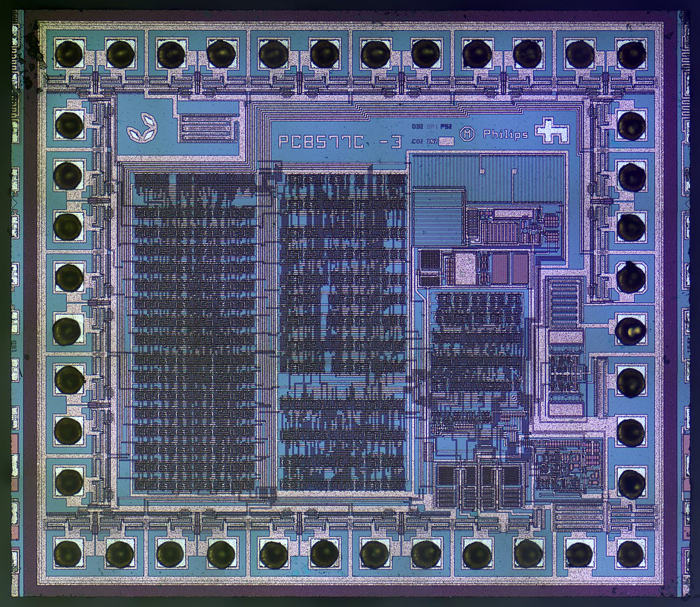
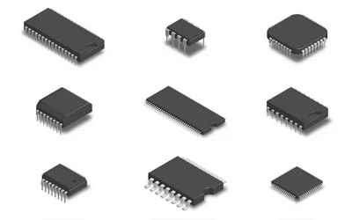
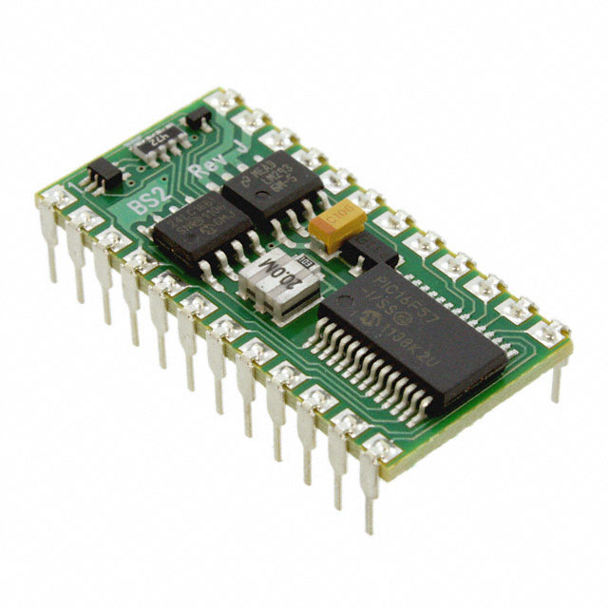
Introduction to VLSI
Very Large-Scale Integration (VLSI) represents a pivotal era in the evolution of integrated circuit technology, enabling the integration of thousands to millions of transistors onto a single semiconductor silicon chip. This technology has transformed the landscape of modern electronics, facilitating the development of powerful, compact, and energy-efficient electronic devices that pervade almost every aspect of contemporary life.

Slide 4

Moore’s Law
Moore's Law, proposed by Gordon Moore in 1965, observes that the number of transistors on a microchip doubles approximately every two years, while the cost of computers halved. This observation has been foundational in driving the rapid advancement of semiconductor technology, leading to increasingly powerful and compact electronic devices over the decades

Slide 5
VLSI Design Flow
The VLSI design flow is carried out in three domains simultaneously or in step by step process:
Structural Domain: In the structural domain, designs are often described using hardware description languages (HDLs) at a higher level. This domain bridges the gap between the abstract or logical representation of an IC and its physical realization on a semiconductor substrate
Physical Domain: The physical domain in VLSI design encompasses the tangible aspects of circuit creation, focusing on the layout, fabrication processes, and material considerations of integrated circuits.
Behavioural Domain: The behavioral domain in VLSI design refers to the abstraction level where the focus is on the functionality and performance of the circuit without delving into its structural or physical implementation.

Slide 6
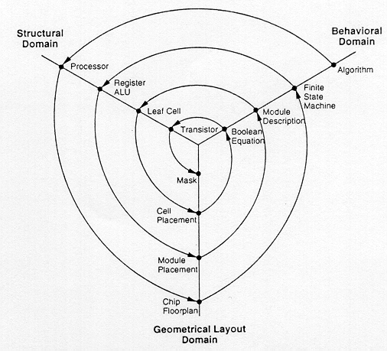
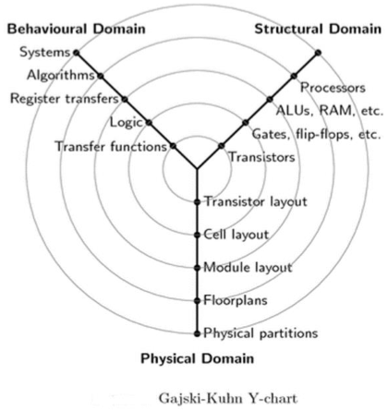
VLSI Design Flow

Slide 7
VLSI Physical Design process
5 major steps
Partitioning and Floorplanning
Placement
Routing
Static timing analysis
Physical design verification and signoff

Slide 8
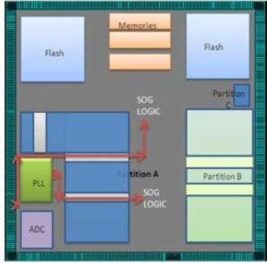
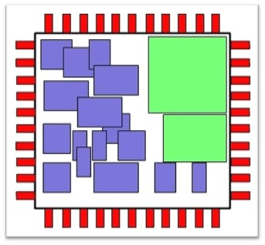
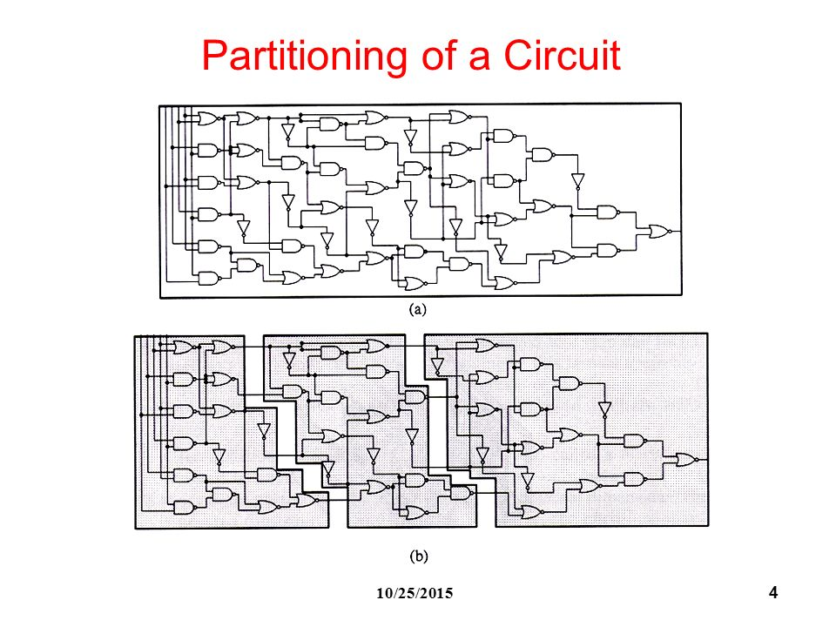
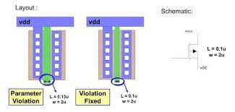
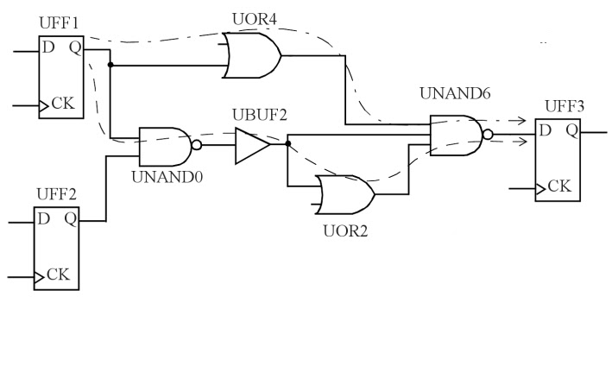
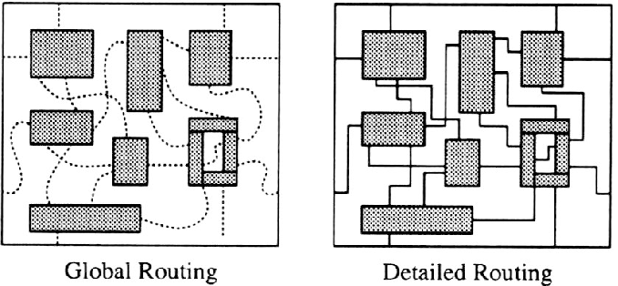
Standard Cell Placement
Partitioning of circuit
Floorplanning
Design Verification
Static Timing Analysis

Slide 9
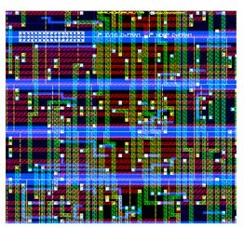
Routing Problem
The routing problem in VLSI (Very Large Scale Integration) design is a critical aspect that involves determining the physical paths for interconnecting various components, such as transistors, gates, and cells, on a semiconductor chip. Essentially, routing is the process of establishing electrical connections between these components to facilitate the flow of signals within the integrated circuit (IC).

Slide 10
Maze Algorithms
Maze routing algorithms can be used to solve the routing problem in VLSI design. These algorithms are inspired by maze-solving techniques and aim to find paths through a maze-like grid that represents the chip layout. Key characteristics of maze routing algorithms include:
1. Grid Representation: The chip layout is represented as a grid of cells, where each cell corresponds to a routing track or routing channel. The grid contains obstacles representing fixed objects such as cells, blocks, and routing obstructions.
2. Pathfinding: Maze routing algorithms use pathfinding techniques, such as BFS, and DFS to explore possible routing paths from source to destination points on the grid.
3. Obstacle Avoidance: Maze routing algorithms consider obstacles and routing constraints during pathfinding to avoid collisions with fixed objects and ensure feasible routing paths.
4. Optimization: Various optimization techniques, such as wire length minimization, congestion-aware routing, and timing-driven routing, are integrated into maze routing algorithms to optimize routing paths and meet design objectives.

Slide 11
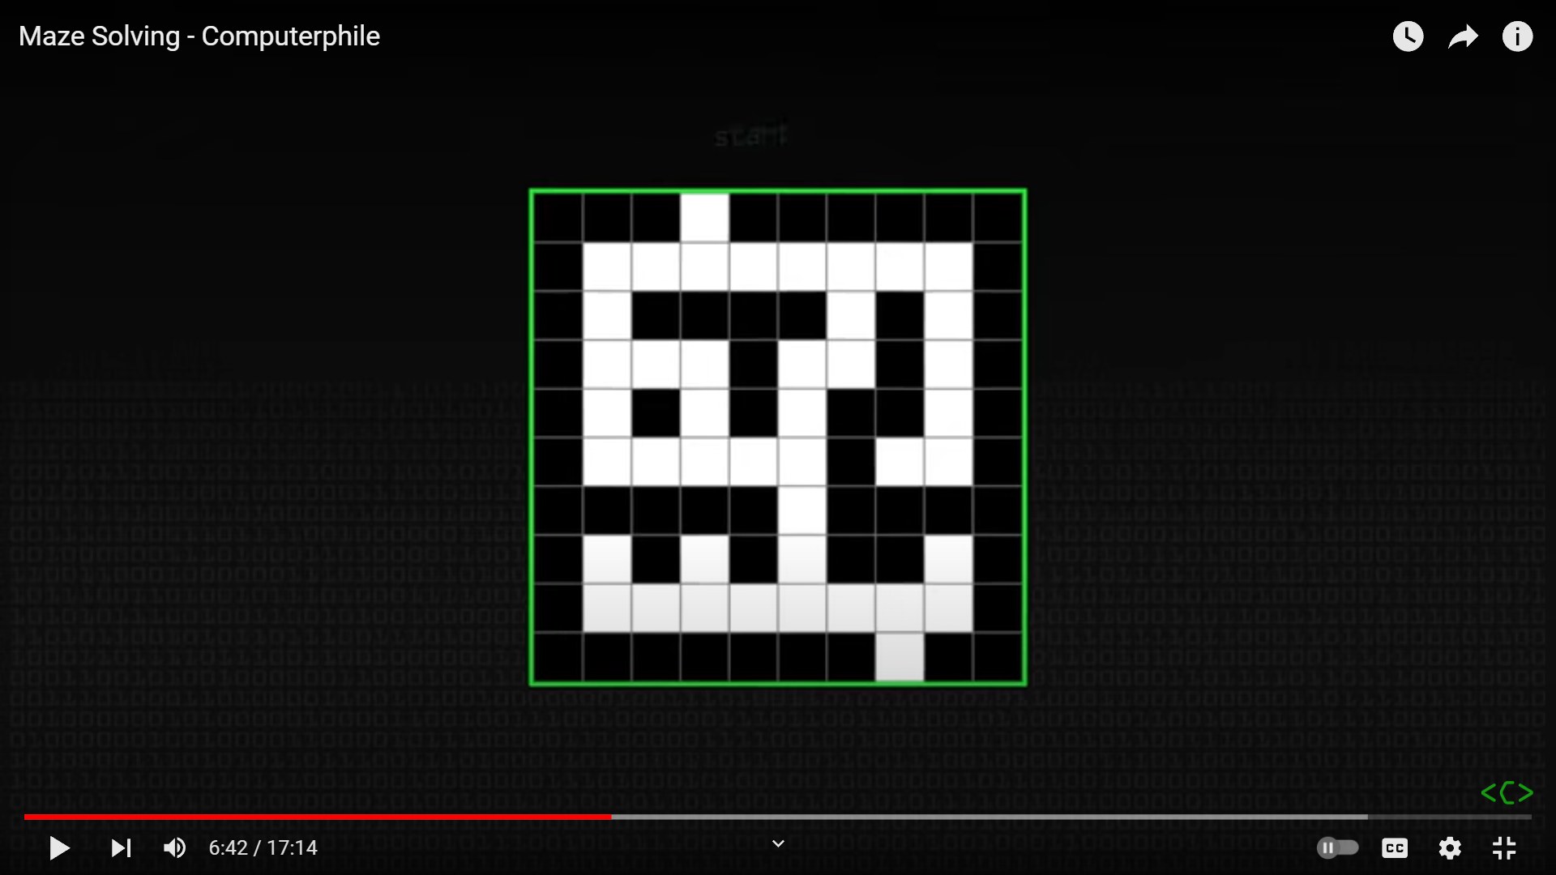
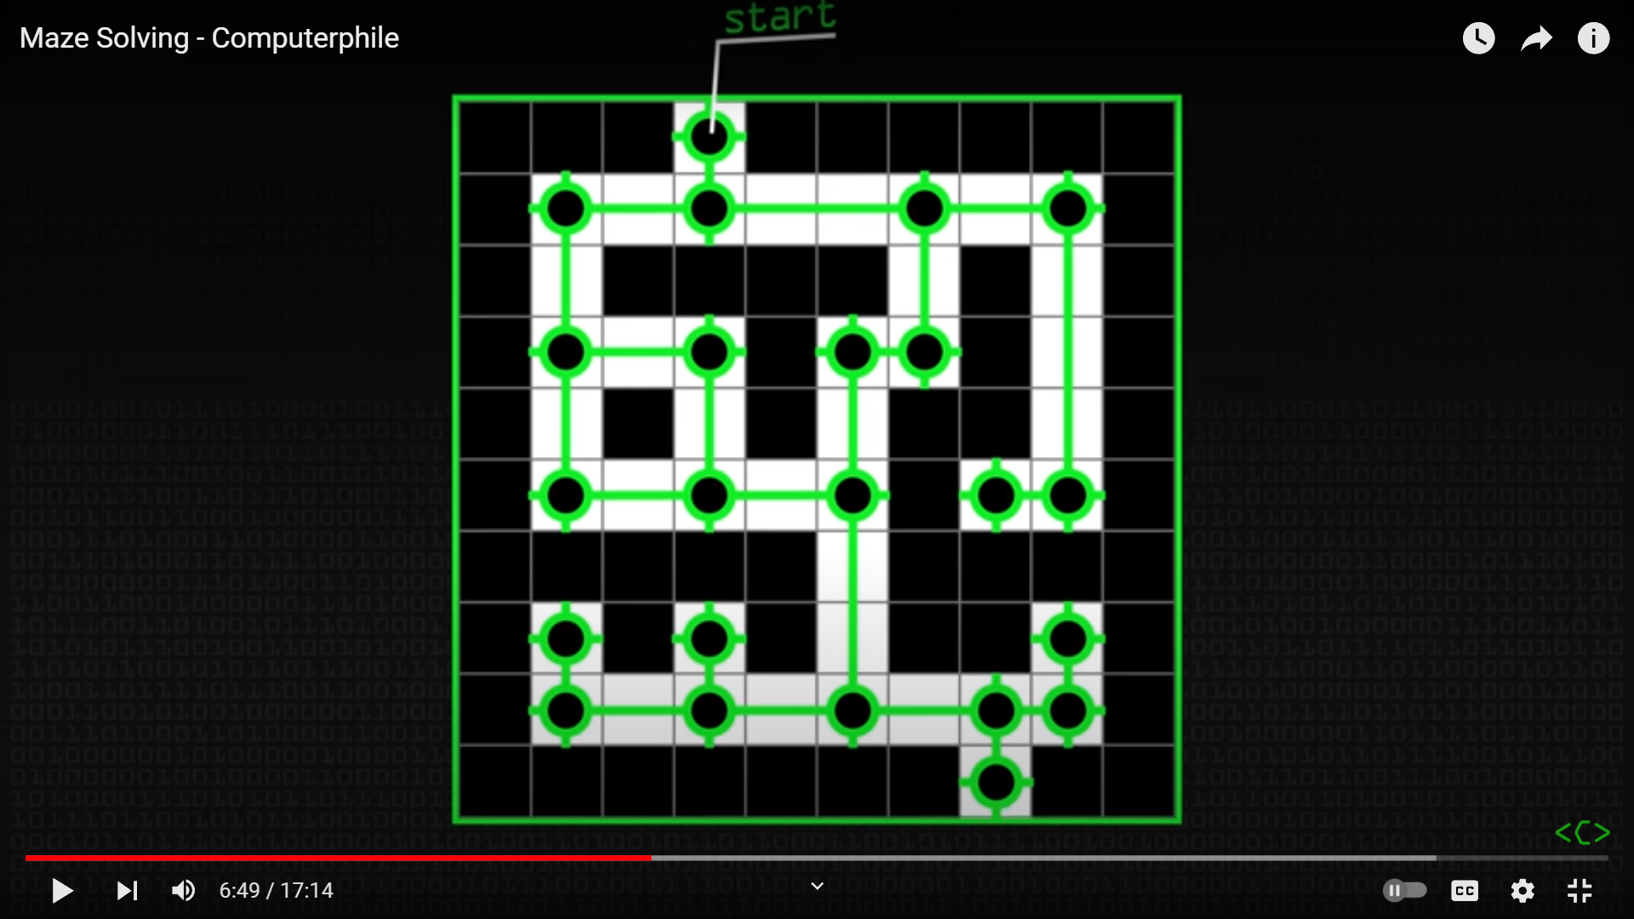
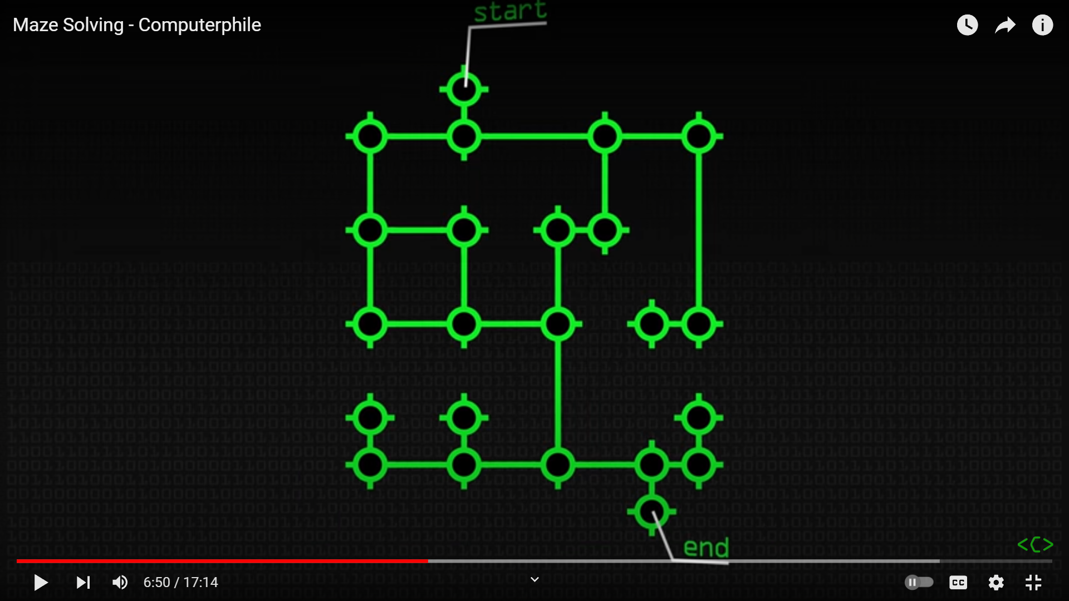
Maze Algorithms

Slide 12
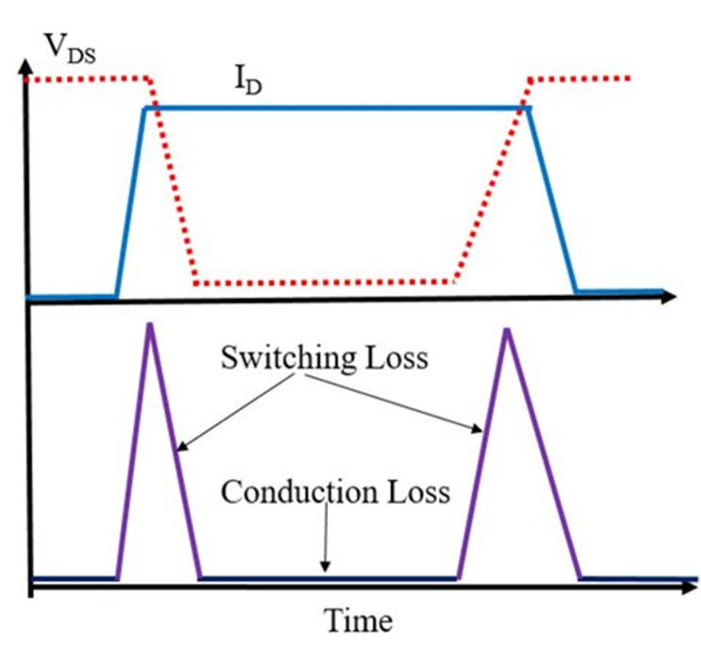
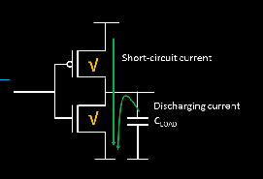
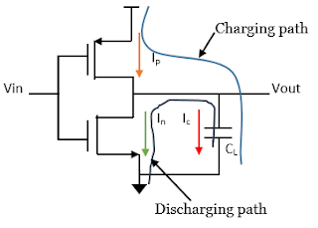
Power Consumption
Power consumption is a very big challenge in modern-day VLSI design. Almost all portable devices run on battery power and as such sometimes optimizing power consumption is more crucial than increasing the performance of the IC. There are majorly 3 types of power dissipation that need to be taken care of when considering VLSI design:
Dynamic Power
Short Circuit Power
Static Power

Slide 13
Power Consumption

Slide 14
Dynamic power optimization
1. Clock Gating: Disabling clock signals to inactive circuit blocks during idle periods reduces switching activity and dynamic power consumption.
2. Power Gating: Temporarily shutting down power to unused circuit blocks or modules minimizes dynamic power consumption.
3. Dynamic Voltage and Frequency Scaling (DVFS): Adjusting the supply voltage and clock frequency dynamically based on workload or performance requirements reduces dynamic power while maintaining desired performance levels.
4. Low-Power Design Techniques: Utilizing energy-efficient circuit design techniques such as asynchronous logic, multi-threshold CMOS, and low-power arithmetic and logic units (ALUs) reduces dynamic power consumption.

Slide 15
Static power optimization
1. Transistor Sizing: Increasing the transistor threshold voltage (Vth) and reducing the subthreshold leakage current by sizing transistors appropriately.
2. Power Gating: Temporarily shutting down power to unused circuit blocks or modules using power gating techniques to reduce leakage currents.
3 Gate Oxide Thickness: Optimizing gate oxide thickness to minimize gate leakage currents, especially in advanced CMOS processes.

Slide 16
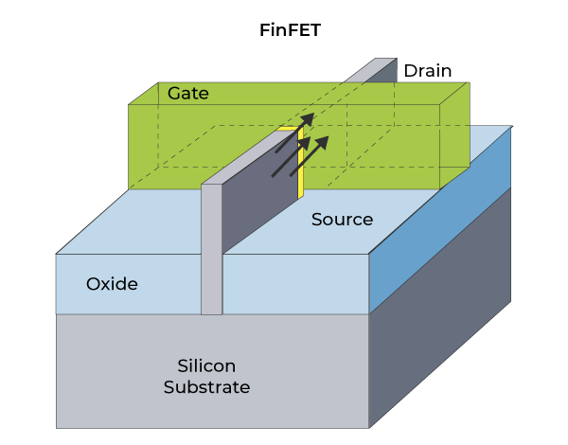
Conclusion
VLSI is an already well-established industry but as technology is advancing, many challenges need to be addressed like power optimization and routing problems.
We can use maze-solving algorithms with defined constraints to solve routing problems and speed up the process.
Power consumption is another challenge that needs to be solved and we need to reduce the dynamic and statin power loss of circuits.
We also face another challenge as technology advances which is the physical limitation of Moore’s Law and we need to explore the field the FinFet technology and quantum computing

Slide 17
References
Algorithms for VLSI Physical Design Automation by Naveed A. Sherwani (Intel Corporation)
VLSI Physical Design NPTEL Course by IIT Kharagpur
Routing Algorithms For VLSI Design by R. Venketeteswaran and P. Mazumder (University of Michigan)
Maze Solving – Computerphile (YouTube Video)
Design of Analog CMOS Integrated Circuits by Behad Razavi

Slide 18
Thank You

